Slide 1
Relational Algebra Part II
CS 236
Fall 2023

Slide 2
Overview
Topics -- Relations and relational operators
Precedence
Union, intersection, set difference on tables
Cartesian product, natural join
Due
Homework 14 due today
Homework 15 due Friday
Project 3 due Thursday, Nov 9
historically one of the more easy projects
be sure to see TA video or notes about __eq__ and __hash__

Slide 3
Relational Algebra – last class review
What is relational algebra?
(set of relations, set of relational operators)
operators = {∩, ∪, −, ρ, σ, π, ×, |×|}

Slide 4
Relational Algebra – last class review
What is relational algebra?
(set of relations, set of relational operators)
operators = {∩, ∪, −, ρ, σ, π, ×, |×|}
ρ is rename
σ is select
π is project
Relation
Unary operator
New Relation

Slide 5
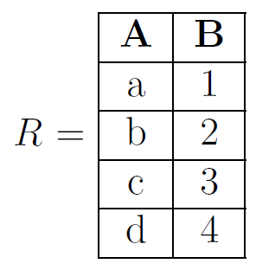
Three ways to represent relations
Set
Textbook
Table
Project 3 and 4
Matrix
We’ll discuss this in a few weeks
Representing Relations

Slide 6
Relational Algebra – last class review
What is relational algebra?
(set of relations, set of relational operators)
operators = {∩, ∪, −, ρ, σ, π, ×, |×|}
ρ is rename
σ is select
π is project
Relation
Unary operator
New Relation
These three are only defined for the table representation

Slide 7
Match
Select
Project
Rename
Switch column order
Choose rows
Change attribute names
Choose columns

Slide 8
Precedence

Slide 9
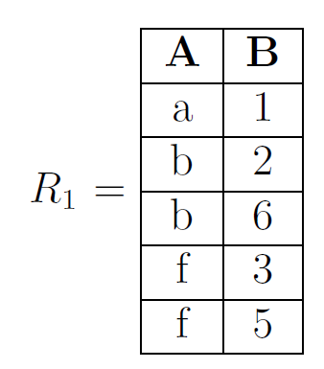
Precedence
Select, Project, and Rename have equal precedence (highest in Relational Algebra). They are evaluated from right to left

Slide 10
Right to left
You’ve seen this before

Slide 11

Right to left
You’ve seen this before

Slide 12


Precedence
Select, Project, and Rename have equal precedence (highest in Relational Algebra). They are evaluated from right to left
Using parentheses can help

Slide 13

Precedence
Select, Project, and Rename have equal precedence (highest in Relational Algebra). They are evaluated from right to left
Using parentheses can help

Slide 14
Binary Relational Operators

Slide 15
Relational Algebra
Union, intersection, set difference for table representation
Cross product, and Natural Join
− is set difference
∩ is intersection
∪ is union
× is cross (Cartesian) product
|×| is natural join
Relation 1
Binary operator
New Relation
Relation 2

Slide 16
Relational Operator | Works on Set Representation? | Table Representation
ρ (rename) | No | Change attributes in header
σ (select) | No | Choose rows
π (project) | No | Choose/reorder columns
− (set difference) | Just like sets
∩ (intersection) | Just like sets
∪ (union) | Just like sets
× (cross or Cartesian product)
|×| is natural join
✅
✅
✅

Slide 17
Union, Intersection, Set Difference

Slide 18
Relational Operations
Union, intersection, difference
Difference is just that we have a set of tuples for each relation
Notes:
R = \{(a,1),(b,2),(c,3)\} \ \ \ \ \ \
S = \{(a,1),(b,4),(d,5)\}
R\cup S = \{(a,1),(b,2),(c,3),(b,4),(d,5)\}

Slide 19
Relational Operations – on table representation
Union, intersection, difference on table just like on sets
Differences
Set of tuples for each relation
Attributes must be the same
Notes:
R = \{(a,1),(b,2),(c,3)\} \ \ \ \ \ \
S = \{(a,1),(b,4),(d,5)\}
R\cup S = \{(a,1),(b,2),(c,3),(b,4),(d,5)\}

Slide 20
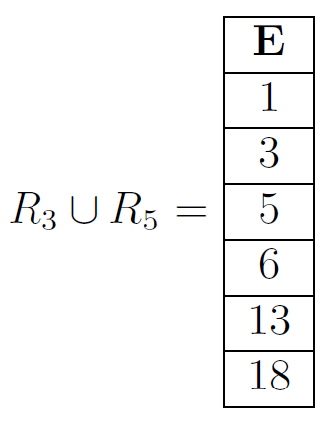
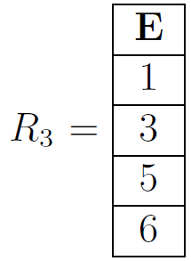
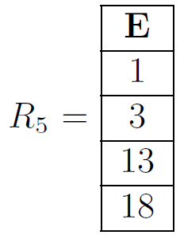
Example – Union
Same as union with sets, but attributes must be the same

Slide 21
Example – Union
Same as union with sets, but attributes must be the same
A | B
a | 1
b | 2
c | 3
A | B
A | B
a | 1
b | 4
d | 5
Notes:
R = \{(a,1),(b,2),(c,3)\} \ \ \ \ \ \
S = \{(a,1),(b,4),(d,5)\}
R\cup S = \{(a,1),(b,2),(c,3),(b,4),(d,5)\}

Slide 22
Example – Union
Same as union with sets, but attributes must be the same
A | B
a | 1
b | 2
c | 3
A | B
a | 1
b | 2
c | 3
b | 4
d | 5
A | B
a | 1
b | 4
d | 5
Notes:
R = \{(a,1),(b,2),(c,3)\} \ \ \ \ \ \
S = \{(a,1),(b,4),(d,5)\}
R\cup S = \{(a,1),(b,2),(c,3),(b,4),(d,5)\}

Slide 23
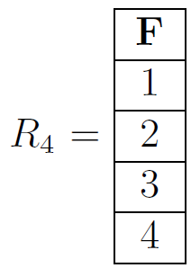

Example – Union
Same as union with sets, but attributes must be the same

Slide 24
Example – Union
Same as union with sets, but attributes must be the same
Don’t match
Undefined!
There is no answer

Slide 25
Relational Operator | Works on Set Representation? | Table Representation
ρ (rename) | No | Change attributes in header
σ (select) | No | Choose rows
π (project) | No | Choose/reorder columns
− (set difference) | Just like sets | Yes if attributes match
∩ (intersection) | Just like sets | Yes if attributes match
∪ (union) | Just like sets | Yes if attributes match
× (cross or Cartesian product) | Just like sets | Yes if attributes are different
|×| is natural join
✅
✅
✅
✅
✅
✅

Slide 26
Cross Product

Slide 27
Cross Product – on Sets
Same as Cartesian product for sets

Slide 28
Cross Product – on Sets
Same as Cartesian product for sets

Slide 29
Cross Product – on Sets
Same as Cartesian product for sets
WRONG

Slide 30
Cross Product – on Sets
Same as Cartesian product for sets
This is a tuple type

Slide 31
Cross Product – on Sets
Same as Cartesian product for sets
This is a tuple type
This is an integer type

Slide 32
Cross Product – on Sets
Same as Cartesian product for sets
This is a tuple type
I want a tuple of one-tuples

Slide 33
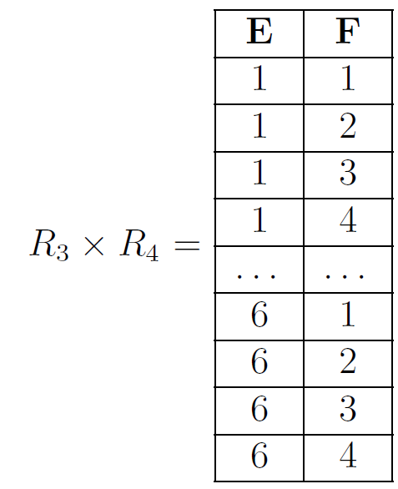
Cross Product – On Tables
Same as Cartesian product for sets but attributes must be different

Slide 34
Cross Product – On Tables
Same as Cartesian product for sets but attributes must be different
A | B
a | 1
b | 2
c | 3
A | B
a | 1
b | 4
d | 5
Undefined

Slide 35
Cross Product – On Tables
Same as Cartesian product for sets but attributes must be different
A | B
a | 1
b | 2
c | 3
C | D
a | 1
b | 4
d | 5
Okay

Slide 36
Cross Product – On Tables
Same as Cartesian product for sets but attributes must be different
A | B
a | 1
b | 2
c | 3
A | B | C | D
C | D
a | 1
b | 4
d | 5
Merge
Attributes

Slide 37
Cross Product – On Tables
Same as Cartesian product for sets but attributes must be different
A | B
a | 1
b | 2
c | 3
A | B | C | D
C | D
a | 1
b | 4
d | 5

Slide 38
Cross Product – On Tables
Same as Cartesian product for sets but attributes must be different
A | B
a | 1
b | 2
c | 3
A | B | C | D
a | 1 | a | 1
a | 1 | b | 4
a | 1 | d | 5
b | 2 | a | 1
b | 2 | b | 4
… | … | … | …
C | D
a | 1
b | 4
d | 5

Slide 39
Cross Product – A subtle difference between sets and tables
A | B
a | 1
b | 2
c | 3
A | B | C | D
a | 1 | a | 1
a | 1 | b | 4
a | 1 | d | 5
b | 2 | a | 1
b | 2 | b | 4
… | … | … | …
C | D
a | 1
b | 4
d | 5

Slide 40
Cross Product – A subtle difference between sets and tables
An ordered pair of ordered pairs
A | B
a | 1
b | 2
c | 3
A | B | C | D
a | 1 | a | 1
a | 1 | b | 4
a | 1 | d | 5
b | 2 | a | 1
b | 2 | b | 4
… | … | … | …
C | D
a | 1
b | 4
d | 5

Slide 41
Cross Product – A subtle difference between sets and tables
An ordered pair of ordered pairs
A | B
a | 1
b | 2
c | 3
A | B | C | D
a | 1 | a | 1
a | 1 | b | 4
a | 1 | d | 5
b | 2 | a | 1
b | 2 | b | 4
… | … | … | …
C | D
a | 1
b | 4
d | 5
An ordered four-tuple (a,1,a,1)

Slide 42
Cross Product – A subtle difference between sets and tables

Slide 43
Cross Product – A subtle difference between sets and tables

Slide 44
Cross Product – A subtle difference between sets and tables

Slide 45
Cross Product – A subtle difference between sets and tables
Sets:

Slide 46
Cross Product – A subtle difference between sets and tables
Sets:
Tables:
A | B | C
a | 0 | x
a | 0 | y
a | 1 | x
a | 1 | y
 | …
b | 1 | y

Slide 47
Relational Operator | Works on Set Representation? | Table Representation
ρ (rename) | No | Change attributes in header
σ (select) | No | Choose rows
π (project) | No | Choose/reorder columns
− (set difference) | Just like sets | Yes if attributes match
∩ (intersection) | Just like sets | Yes if attributes match
∪ (union) | Just like sets | Yes if attributes match
× (cross or Cartesian product) | Just like sets | Yes if attributes are different
|×| is natural join | No | Join common attributes, cross product different attributes
✅
✅
✅
✅
✅
✅
✅

Slide 48
Natural Join

Slide 49
Natural Join – Two Forms
When attributes match
When attributes don’t match

Slide 50
Natural Join – Two Forms
When attributes match
When attributes don’t match

Slide 51

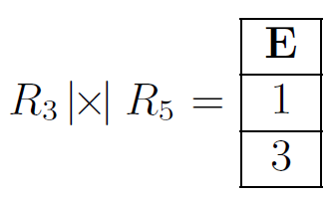
Natural Join – When Attributes Match
Also called Join, denoted by
Combine common attributes with matching row values
Same as intersection when attributes match

Slide 52
Natural Join – When Attributes Match
Also called Join, denoted by
Combine common attributes with matching row values
Same as intersection when attributes match

Slide 53
Natural Join – When Attributes Match
Also called Join, denoted by
Combine common attributes with matching row values
Same as intersection when attributes match

Slide 54
Natural Join – When Attributes Match
Also called Join, denoted by
Combine common attributes with matching row values
Same as intersection when attributes match

Slide 55
Natural Join – When Attributes Match
Also called Join, denoted by
Combine common attributes with matching row values
Same as intersection when attributes match

Slide 56
Natural Join – When Attributes Match
Also called Join, denoted by
Combine common attributes with matching row values
Same as intersection when attributes match

Slide 57
Natural Join – Two Forms
When attributes match
When attributes don’t match

Slide 58

Natural Join – When Attributes Don’t Match
Also called Join, denoted by
When no attributes match, same as Cross product

Slide 59
Natural Join – When Attributes Don’t Match
Also called Join, denoted by
When no attributes match, same as Cross product

Slide 60
Natural Join – Two Forms Three Forms
When attributes match
When attributes don’t match
Some attributes match
Some don’t

Slide 61
Two natural join implementations

Slide 62
Method 1: Minimize Execution Time

Slide 63
Efficient Natural Join
make the header h for the result relation (combine r1's header with r2's header)
make a new empty relation r using header h
for each tuple t1 in r1
for each tuple t2 in r2
if t1 and t2 can join join t1 and t2 to make tuple t
add tuple t to relation r
end if
end for
end for

Slide 64
Efficient Natural Join
make the header h for the result relation (combine r1's header with r2's header)
make a new empty relation r using header h
for each tuple t1 in r1
for each tuple t2 in r2
if t1 and t2 can join join t1 and t2 to make tuple t
add tuple t to relation r
end if
end for
end for

Slide 65
Efficient Natural Join
Intersect common attributes
Cross product different attributes
A | B
a | 1
b | 2
c | 3
A | D
a | 1
a | 4
c | 5
d | 3
Notes:
R\ |\hspace*{-.05in}\times\hspace*{-.05in}| \ S

Slide 66
Efficient Natural Join
Intersect common attributes
Cross product different attributes
A | B
a | 1
b | 2
c | 3
A | B | D
A | D
a | 1
a | 4
c | 5
d | 3
Notes:
R\ |\hspace*{-.05in}\times\hspace*{-.05in}| \ S

Slide 67
Efficient Natural Join
Intersect common attributes
Cross product different attributes
A | B
a | 1
b | 2
c | 3
A | B | D
A | D
a | 1
a | 4
c | 5
d | 3
Notes:
R\ |\hspace*{-.05in}\times\hspace*{-.05in}| \ S

Slide 68
Efficient Natural Join
make the header h for the result relation (combine r1's header with r2's header)
make a new empty relation r using header h
for each tuple t1 in r1
for each tuple t2 in r2
if t1 and t2 can join join t1 and t2 to make tuple t
add tuple t to relation r
end if
end for
end for

Slide 69
Efficient Natural Join
Intersect common attributes
Cross product different attributes
A | B
a | 1
b | 2
c | 3
A | B | D
A | D
a | 1
a | 4
c | 5
d | 3
Notes:
R\ |\hspace*{-.05in}\times\hspace*{-.05in}| \ S

Slide 70
Efficient Natural Join
make the header h for the result relation (combine r1's header with r2's header)
make a new empty relation r using header h
for each tuple t1 in r1
for each tuple t2 in r2
if t1 and t2 can join join t1 and t2 to make tuple t
add tuple t to relation r
end if
end for
end for

Slide 71
Efficient Natural Join
Intersect common attributes
Cross product different attributes
A | B
a | 1
b | 2
c | 3
A | B | D
A | D
a | 1
a | 4
c | 5
d | 3
for each tuple in R
for each tuple in S
if values in common attributes match, add them to the table
else continue
Notes:
R\ |\hspace*{-.05in}\times\hspace*{-.05in}| \ S

Slide 72
Efficient Natural Join
make the header h for the result relation (combine r1's header with r2's header)
make a new empty relation r using header h
for each tuple t1 in r1
for each tuple t2 in r2
if t1 and t2 can join join t1 and t2 to make tuple t
add tuple t to relation r
end if
end for
end for

Slide 73
Efficient Natural Join
Intersect common attributes
Cross product different attributes
match
A | B
a | 1
b | 2
c | 3
A | B | D
A | D
a | 1
a | 4
c | 5
d | 3
for each tuple in R
for each tuple in S
if values in common attributes match, add them to the table
else continue
Notes:
R\ |\hspace*{-.05in}\times\hspace*{-.05in}| \ S

Slide 74
Efficient Natural Join
make the header h for the result relation (combine r1's header with r2's header)
make a new empty relation r using header h
for each tuple t1 in r1
for each tuple t2 in r2
if t1 and t2 can join join t1 and t2 to make tuple t
add tuple t to relation r
end if
end for
end for

Slide 75
Efficient Natural Join
Intersect common attributes
Cross product different attributes
A | B
a | 1
b | 2
c | 3
A | B | D
a
A | D
a | 1
a | 4
c | 5
d | 3
for each tuple in R
for each tuple in S
if values in common attributes match, add them to the table
else continue
Notes:
R\ |\hspace*{-.05in}\times\hspace*{-.05in}| \ S

Slide 76
Efficient Natural Join
Intersect common attributes
Cross product different attributes
A | B
a | 1
b | 2
c | 3
A | B | D
a | 1
A | D
a | 1
a | 4
c | 5
d | 3
for each tuple in R
for each tuple in S
if values in common attributes match, add them to the table
else continue
Notes:
R\ |\hspace*{-.05in}\times\hspace*{-.05in}| \ S

Slide 77
Efficient Natural Join
Intersect common attributes
Cross product different attributes
A | B
a | 1
b | 2
c | 3
A | B | D
a | 1 | 1
A | D
a | 1
a | 4
c | 5
d | 3
for each tuple in R
for each tuple in S
if values in common attributes match, add them to the table
else continue
Notes:
R\ |\hspace*{-.05in}\times\hspace*{-.05in}| \ S

Slide 78
Efficient Natural Join
Intersect common attributes
Cross product different attributes
match
A | B
a | 1
b | 2
c | 3
A | B | D
a | 1 | 1
a | 1 | 4
A | D
a | 1
a | 4
c | 5
d | 3
for each tuple in R
for each tuple in S
if values in common attributes match, add them to the table
else continue
Notes:
R\ |\hspace*{-.05in}\times\hspace*{-.05in}| \ S

Slide 79
Efficient Natural Join
Intersect common attributes
Cross product different attributes
doesn’t match
A | B
a | 1
b | 2
c | 3
A | B | D
a | 1 | 1
a | 1 | 4
A | D
a | 1
a | 4
c | 5
d | 3
for each tuple in R
for each tuple in S
if values in common attributes match, add them to the table
else continue
Notes:
R\ |\hspace*{-.05in}\times\hspace*{-.05in}| \ S

Slide 80
Efficient Natural Join
Intersect common attributes
Cross product different attributes
doesn’t match
A | B
a | 1
b | 2
c | 3
A | B | D
a | 1 | 1
a | 1 | 4
A | D
a | 1
a | 4
c | 5
d | 3
for each tuple in R
for each tuple in S
if values in common attributes match, add them to the table
else continue
Notes:
R\ |\hspace*{-.05in}\times\hspace*{-.05in}| \ S

Slide 81
Efficient Natural Join
Intersect common attributes
Cross product different attributes
doesn’t match
A | B
a | 1
b | 2
c | 3
A | B | D
a | 1 | 1
a | 1 | 4
A | D
a | 1
a | 4
c | 5
d | 3
for each tuple in R
for each tuple in S
if values in common attributes match, add them to the table
else continue
Notes:
R\ |\hspace*{-.05in}\times\hspace*{-.05in}| \ S

Slide 82
Efficient Natural Join
Intersect common attributes
Cross product different attributes
doesn’t match
A | B
a | 1
b | 2
c | 3
A | B | D
a | 1 | 1
a | 1 | 4
A | D
a | 1
a | 4
c | 5
d | 3
for each tuple in R
for each tuple in S
if values in common attributes match, add them to the table
else continue
Notes:
R\ |\hspace*{-.05in}\times\hspace*{-.05in}| \ S

Slide 83
Efficient Natural Join
Intersect common attributes
Cross product different attributes
match
A | B
a | 1
b | 2
c | 3
A | B | D
a | 1 | 1
a | 1 | 4
c | 3 | 5
A | D
a | 1
a | 4
c | 5
d | 3
for each tuple in R
for each tuple in S
if values in common attributes match, add them to the table
else continue
Notes:
R\ |\hspace*{-.05in}\times\hspace*{-.05in}| \ S

Slide 84
Efficient Natural Join
Intersect common attributes
Cross product different attributes
Check your understanding
What is
S |x| R
A | B
a | 1
b | 2
c | 3
A | D
a | 1
a | 4
c | 5
d | 3
for each tuple in R
for each tuple in S
if values in common attributes match, add them to the table
else continue
Notes:
R\ |\hspace*{-.05in}\times\hspace*{-.05in}| \ S

Slide 85
Efficient Natural Join
Intersect common attributes
Cross product different attributes
Check your understanding
What is
S |x| R
A | B
a | 1
b | 2
c | 3
A | D | B
a | 1 | 1
a | 4 | 1
c | 5 | 3
A | D
a | 1
a | 4
c | 5
d | 3
for each tuple in R
for each tuple in S
if values in common attributes match, add them to the table
else continue
Notes:
R\ |\hspace*{-.05in}\times\hspace*{-.05in}| \ S

Slide 86
Method 2: Minimize Number of Methods to Write

Slide 87
Natural Join Using Existing Operators
Alternate approach:
rename, cross product,
select, project
Intersect common attributes
Cross product different attributes
A | B
a | 1
b | 2
c | 3
A | D
a | 1
a | 4
c | 5
d | 3
Notes:
R\ |\hspace*{-.05in}\times\hspace*{-.05in}| \ S

Slide 88
Natural Join Using Existing Operators
Alternate approach:
rename, cross product,
select, project
Intersect common attributes
Cross product different attributes
A | B
a | 1
b | 2
c | 3
A | D
a | 1
a | 4
c | 5
d | 3
Rename common attributes
Notes:
R\ |\hspace*{-.05in}\times\hspace*{-.05in}| \ S

Slide 89
Natural Join Using Existing Operators
Alternate approach:
rename, cross product,
select, project
Intersect common attributes
Cross product different attributes
A | B
a | 1
b | 2
c | 3
A’ | D
a | 1
a | 4
c | 5
d | 3
Rename common attributes
Notes:
R\ |\hspace*{-.05in}\times\hspace*{-.05in}| \ S

Slide 90
Natural Join Using Existing Operators
Alternate approach:
rename, cross product,
select, project
Intersect common attributes
Cross product different attributes
A | B
a | 1
b | 2
c | 3
A’ | D
a | 1
a | 4
c | 5
d | 3
Take cross product on
renamed relation
Notes:
R\ |\hspace*{-.05in}\times\hspace*{-.05in}| \ S

Slide 91
Natural Join Using Existing Operators
Alternate approach:
rename, cross product,
select, project
Intersect common attributes
Cross product different attributes
A | B
a | 1
b | 2
c | 3
A | B | A’ | D
A’ | D
a | 1
a | 4
c | 5
d | 3
Take cross product on
renamed relation
Notes:
R\ |\hspace*{-.05in}\times\hspace*{-.05in}| \ S

Slide 92
Natural Join Using Existing Operators
Alternate approach:
rename, cross product,
select, project
Intersect common attributes
Cross product different attributes
A | B
a | 1
b | 2
c | 3
A | B | A’ | D
a | 1 | a | 1
a | 1 | a | 4
a | 1 | c | 5
…
c | 3 | c | 5
c | 3 | d | 3
A’ | D
a | 1
a | 4
c | 5
d | 3
Notes:
R\ |\hspace*{-.05in}\times\hspace*{-.05in}| \ S

Slide 93
Natural Join Using Existing Operators
Alternate approach:
rename, cross product,
select, project
Intersect common attributes
Cross product different attributes
A | B
a | 1
b | 2
c | 3
A | B | A’ | D
a | 1 | a | 1
a | 1 | a | 4
a | 1 | c | 5
…
c | 3 | c | 5
c | 3 | d | 3
A’ | D
a | 1
a | 4
c | 5
d | 3
Keep rows with common
A and A’ attributes
Notes:
R\ |\hspace*{-.05in}\times\hspace*{-.05in}| \ S

Slide 94
Natural Join Using Existing Operators
Alternate approach:
rename, cross product,
select, project
Intersect common attributes
Cross product different attributes
A | B
a | 1
b | 2
c | 3
A | B | A’ | D
a | 1 | a | 1
a | 1 | a | 4
c | 3 | c | 5
A’ | D
a | 1
a | 4
c | 5
d | 3
Keep rows with common
A and A’ attributes
Notes:
R\ |\hspace*{-.05in}\times\hspace*{-.05in}| \ S

Slide 95
Natural Join Using Existing Operators
Alternate approach:
rename, cross product,
select, project
Intersect common attributes
Cross product different attributes
A | B
a | 1
b | 2
c | 3
A | B | A’ | D
a | 1 | a | 1
a | 1 | a | 4
c | 3 | c | 5
A’ | D
a | 1
a | 4
c | 5
d | 3
“Project out” renamed attribute
Notes:
R\ |\hspace*{-.05in}\times\hspace*{-.05in}| \ S

Slide 96
Natural Join Using Existing Operators
Alternate approach:
rename, cross product,
select, project
Intersect common attributes
Cross product different attributes
A | B
a | 1
b | 2
c | 3
A | B | A’ | D
a | 1 | a | 1
a | 1 | a | 4
c | 3 | c | 5
A’ | D
a | 1
a | 4
c | 5
d | 3
“Project out” renamed attribute
Notes:
R\ |\hspace*{-.05in}\times\hspace*{-.05in}| \ S

Slide 97
Natural Join Using Existing Operators
Alternate approach:
rename, cross product,
select, project
Intersect common attributes
Cross product different attributes
A | B
a | 1
b | 2
c | 3
A | B | D
a | 1 | 1
a | 1 | 4
c | 3 | 5
A’ | D
a | 1
a | 4
c | 5
d | 3
“Project out” renamed attribute
Notes:
R\ |\hspace*{-.05in}\times\hspace*{-.05in}| \ S

Slide 98
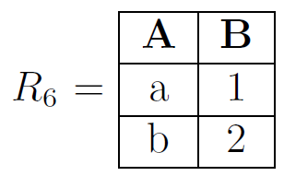
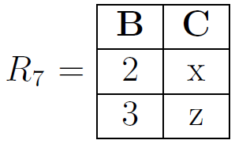
Natural Join Using Existing Operators
Practice

Slide 99
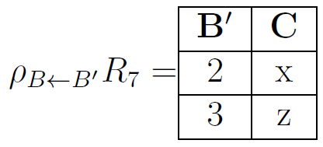
Natural Join Using Existing Operators

Slide 100
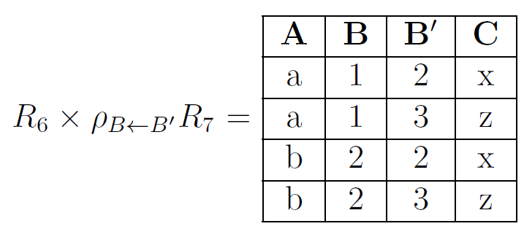
Natural Join Using Existing Operators

Slide 101
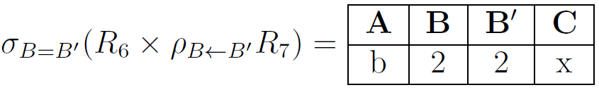
Natural Join Using Existing Operators

Slide 102
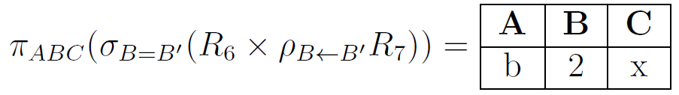
Natural Join Using Existing Operators

Slide 103
Application to Projects
Watch the videos posted under course content for today’s lecture

Slide 104
Precedence
Order of operations for relational operators

Slide 105






Precedence
Select, Project, and Rename are highest then Cross Product and Natural Join, and finally Union (Ignoring Intersection & Set Difference)
Unary operators before Binary
, ,
,

Slide 106
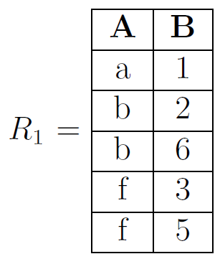
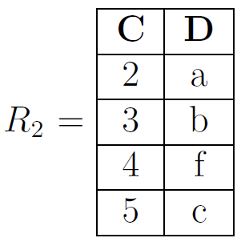

Precedence
Select, Project, and Rename are highest then Cross Product and Natural Join, and finally Union
Unary operators before Binary

Slide 107
Precedence
Select, Project, and Rename are highest then Cross Product and Natural Join, and finally Union
Unary operators before Binary
A
X

Slide 108
Precedence
Select, Project, and Rename are highest then Cross Product and Natural Join, and finally Union
Unary operators before Binary
A
X

Slide 109
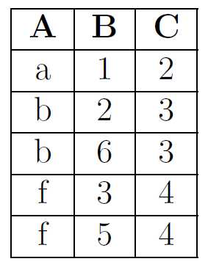
Precedence
Select, Project, and Rename are highest then Cross Product and Natural Join, and finally Union
Unary operators before Binary

